Slide 1

HALF EBAY APPLICATION

Slide 2
HTML ,CSS, JAVASCRIPT
HTML:
HTML stands for Hyper Text Markup Language
HTML is the standard markup language for creating Web pages
HTML describes the structure of a Web page
HTML consists of a series of elements
HTML elements tell the browser how to display the content
HTML elements label pieces of content such as
"this is a heading",
"this is a paragraph",
"this is a link", etc.
<!DOCTYPE html> <html> <head> <title>Page Title</title> </head> <body> <h1>My First Heading</h1> <p>My first paragraph.</p> </body> </html>

Slide 3
CSS
body { background-color: lightblue; } h1 { color: white; text-align: center; } p { font-family: verdana; font-size: 20px; }
CSS stands for Cascading Style Sheets
CSS describes how HTML elements are to be
displayed on screen, paper, or in other media
CSS saves a lot of work.
It can control the layout of multiple web pages all at once
External stylesheets are stored in CSS files
CSS is used to define styles for your web pages,
including the design, layout and variations in display
for different devices and screen sizes.

Slide 4
JAVA SCRIPT
<html>
<head>
<script type = "text/java script">
function fun() {
alert ("This is an alert dialog box");
}
</script>
</head>
<body>
<p> Click the following button to see the effect </p>
<form>
<input type = "button" value = "Click me" onclick = "fun();" />
</form>
</body>
</html>
JavaScript is the world's most popular programming
language.
JavaScript is the programming language of the Web.
JavaScript Can Change HTML Content
JavaScript accepts both double and single quotes
JavaScript Can Change HTML Attribute Values
JavaScript Can Change HTML Styles (CSS)
JavaScript Can Hide HTML Elements
JavaScript Can Show HTML Elements

Slide 5
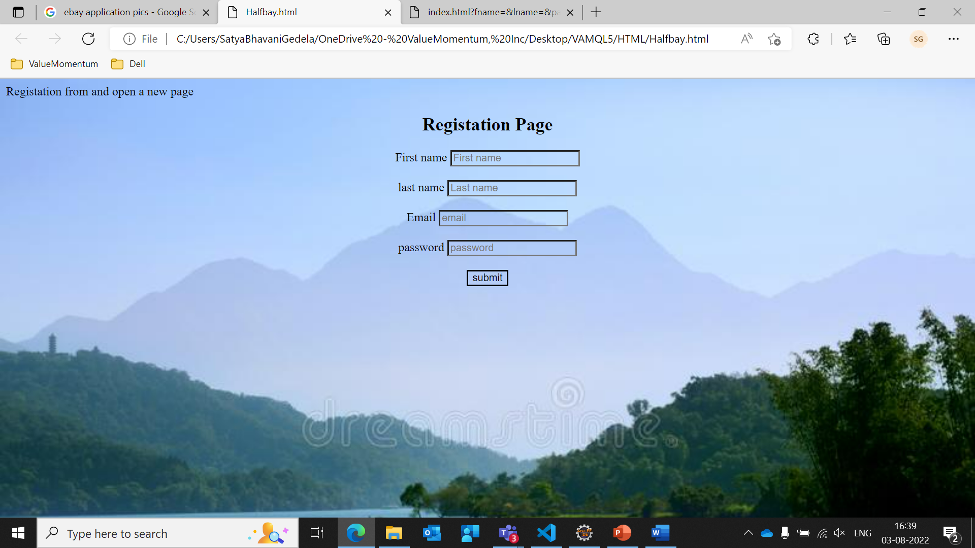
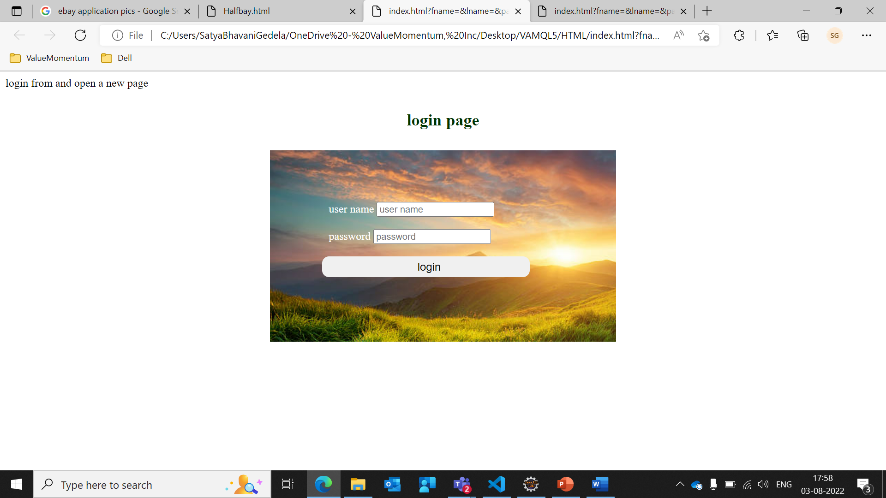
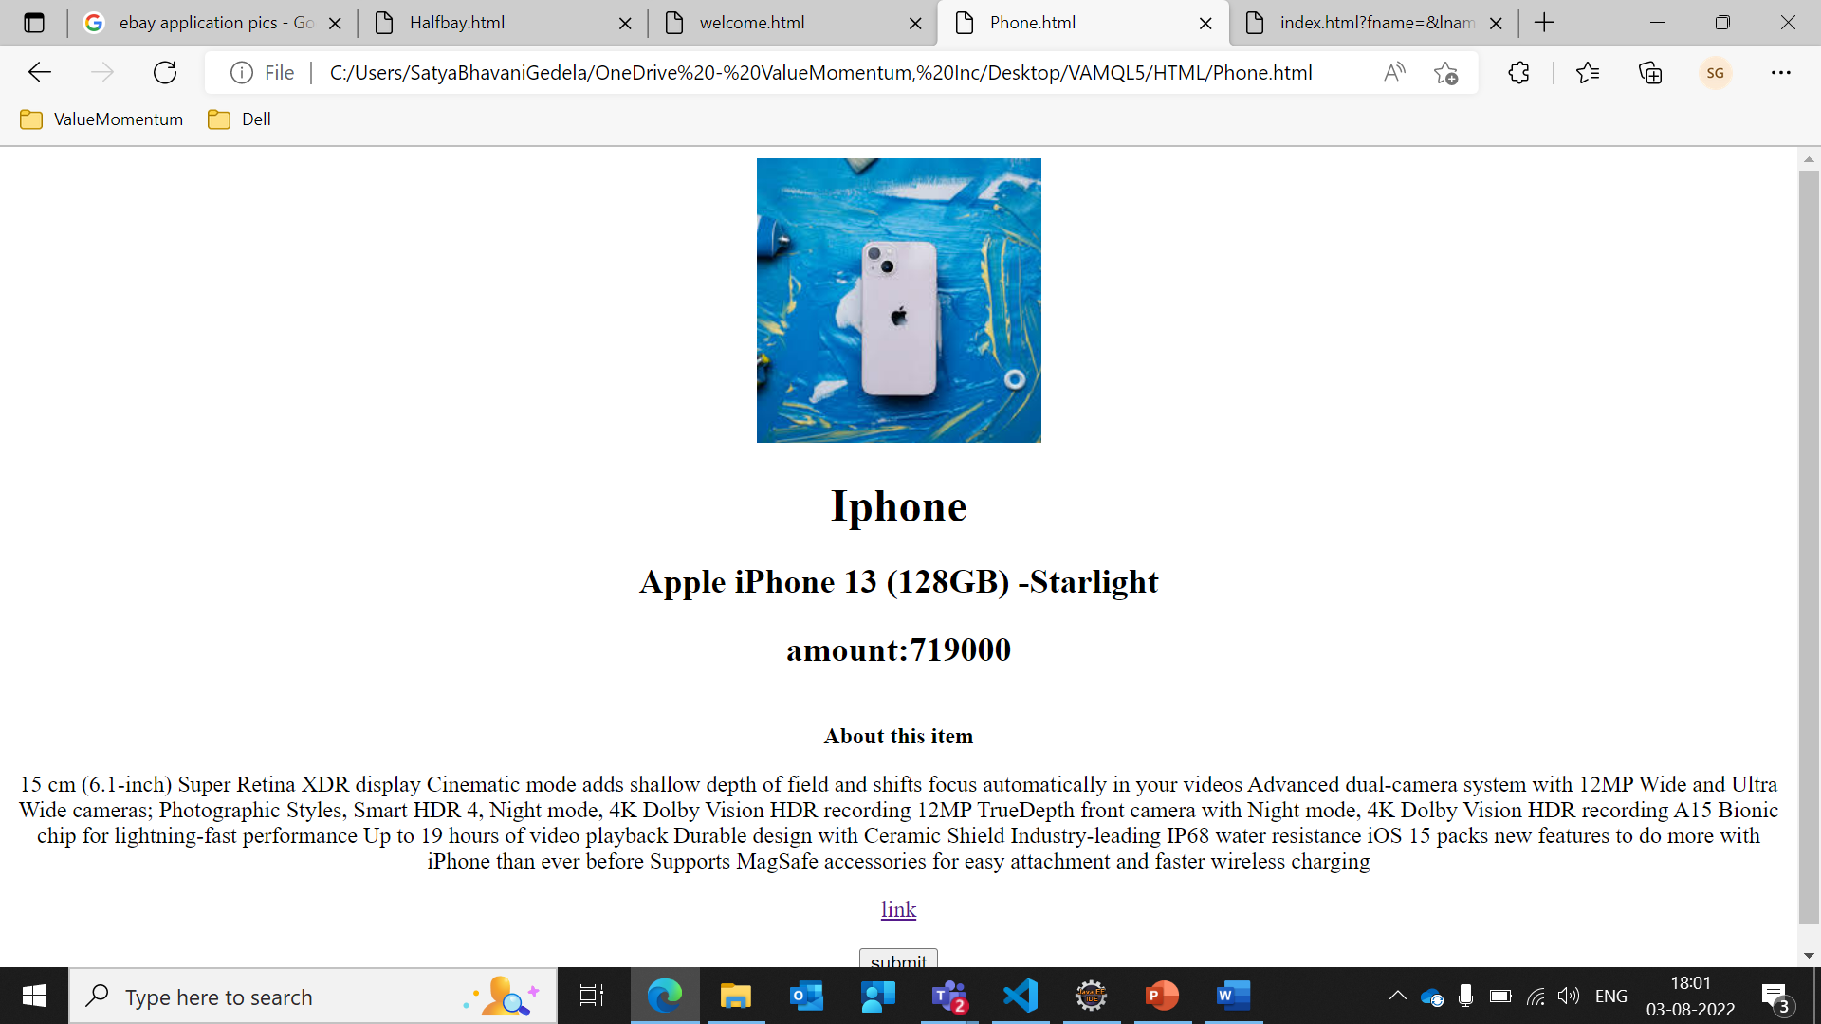
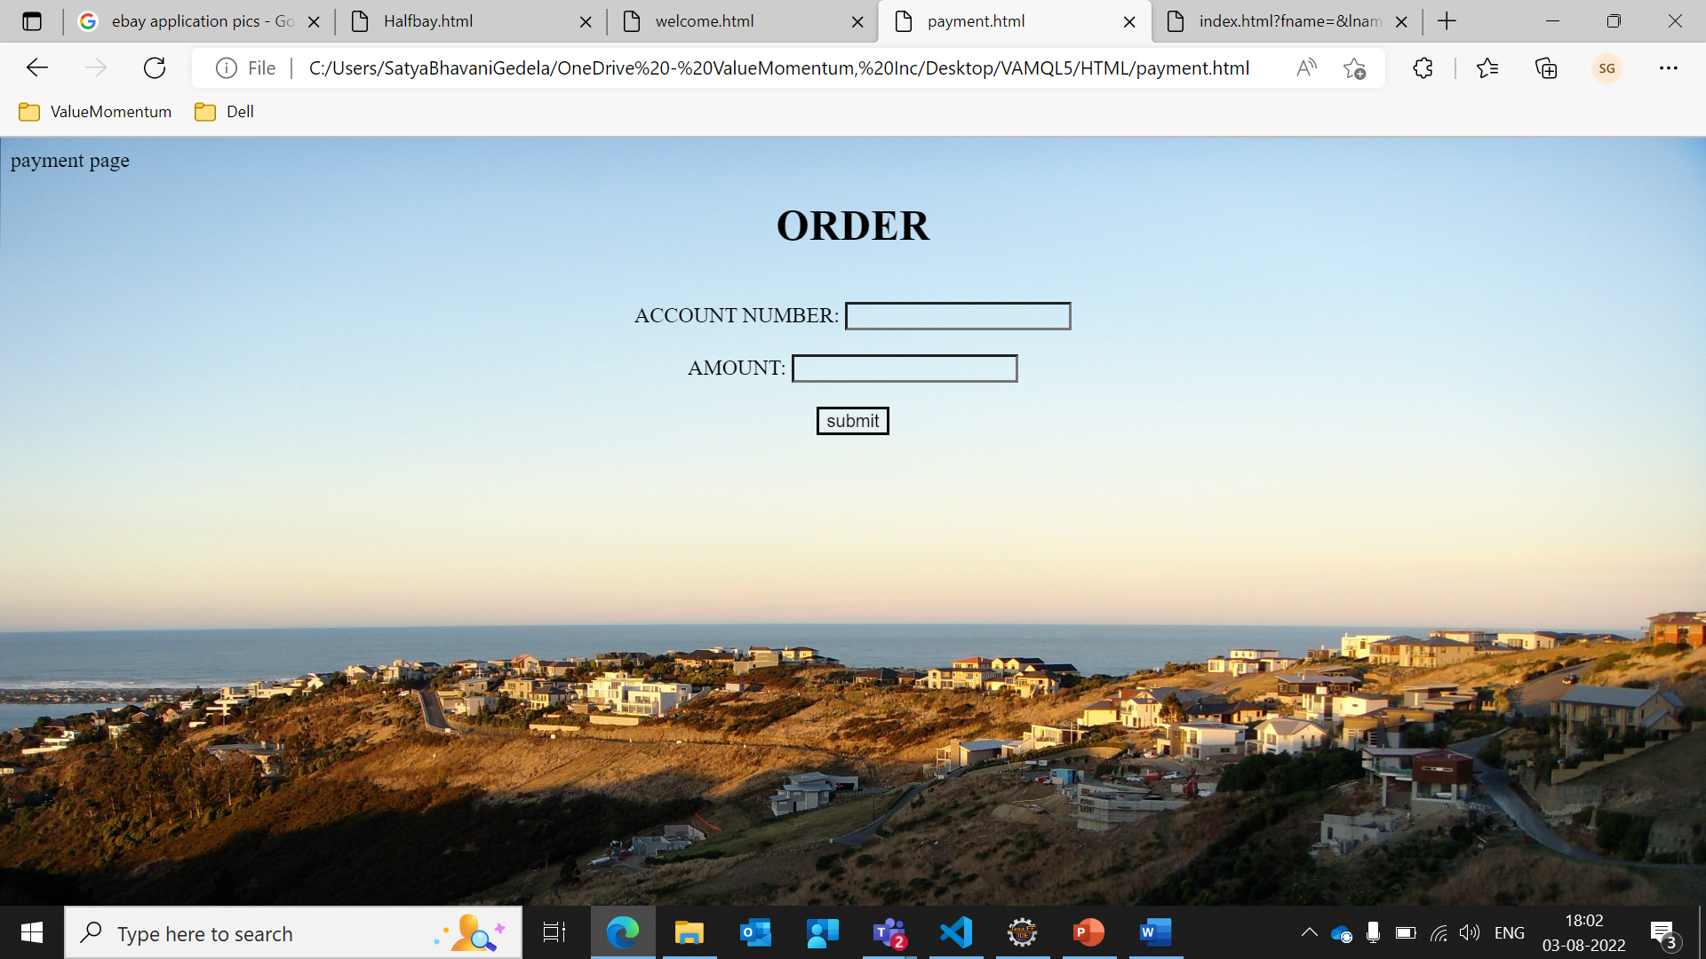
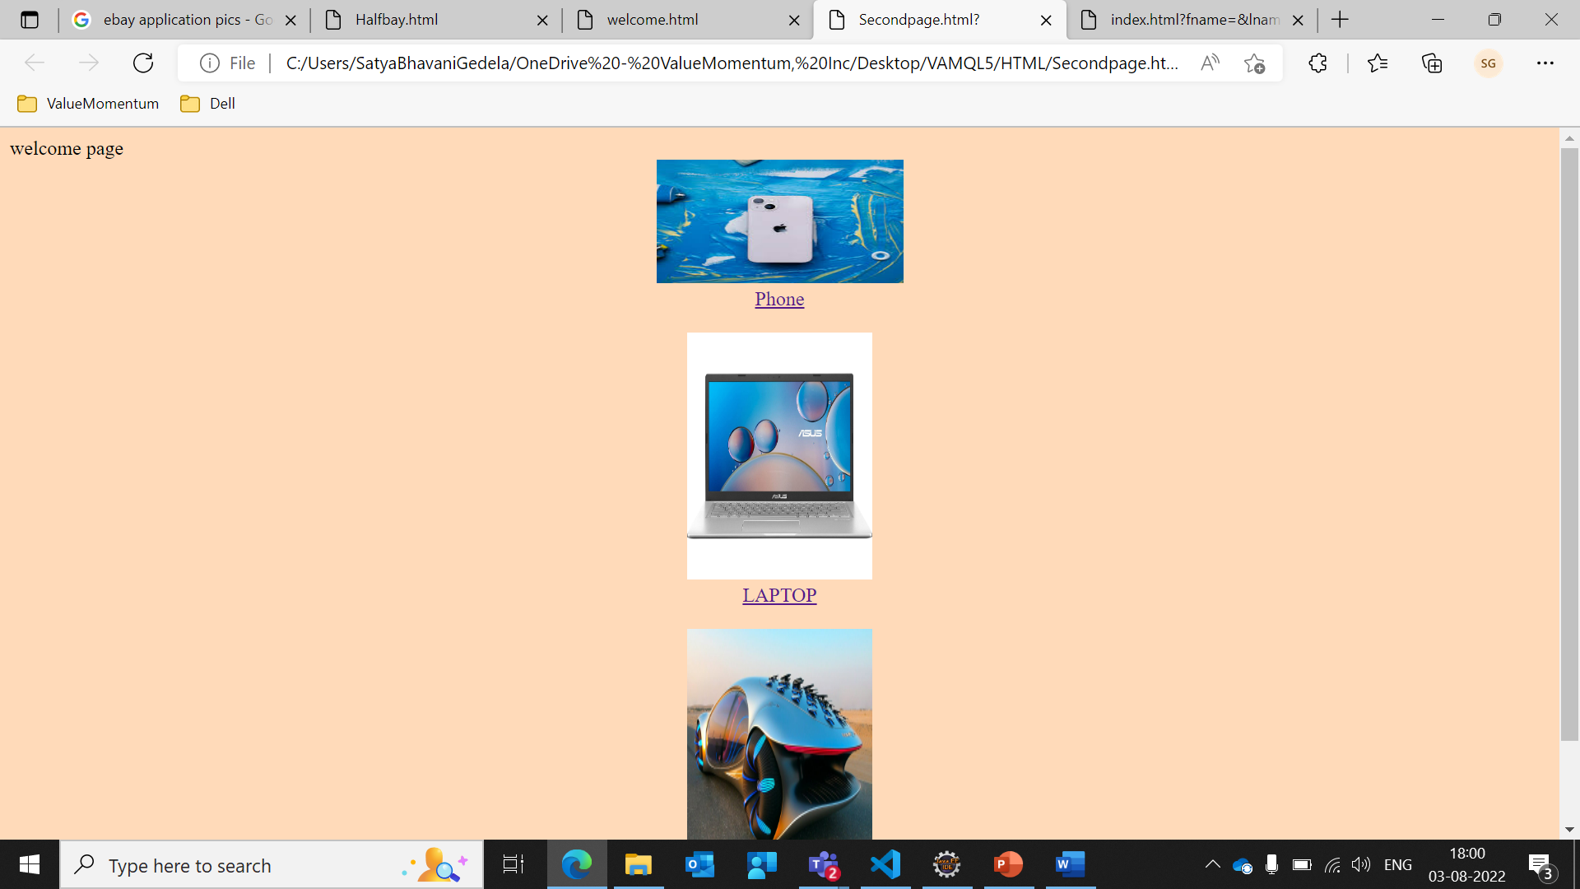
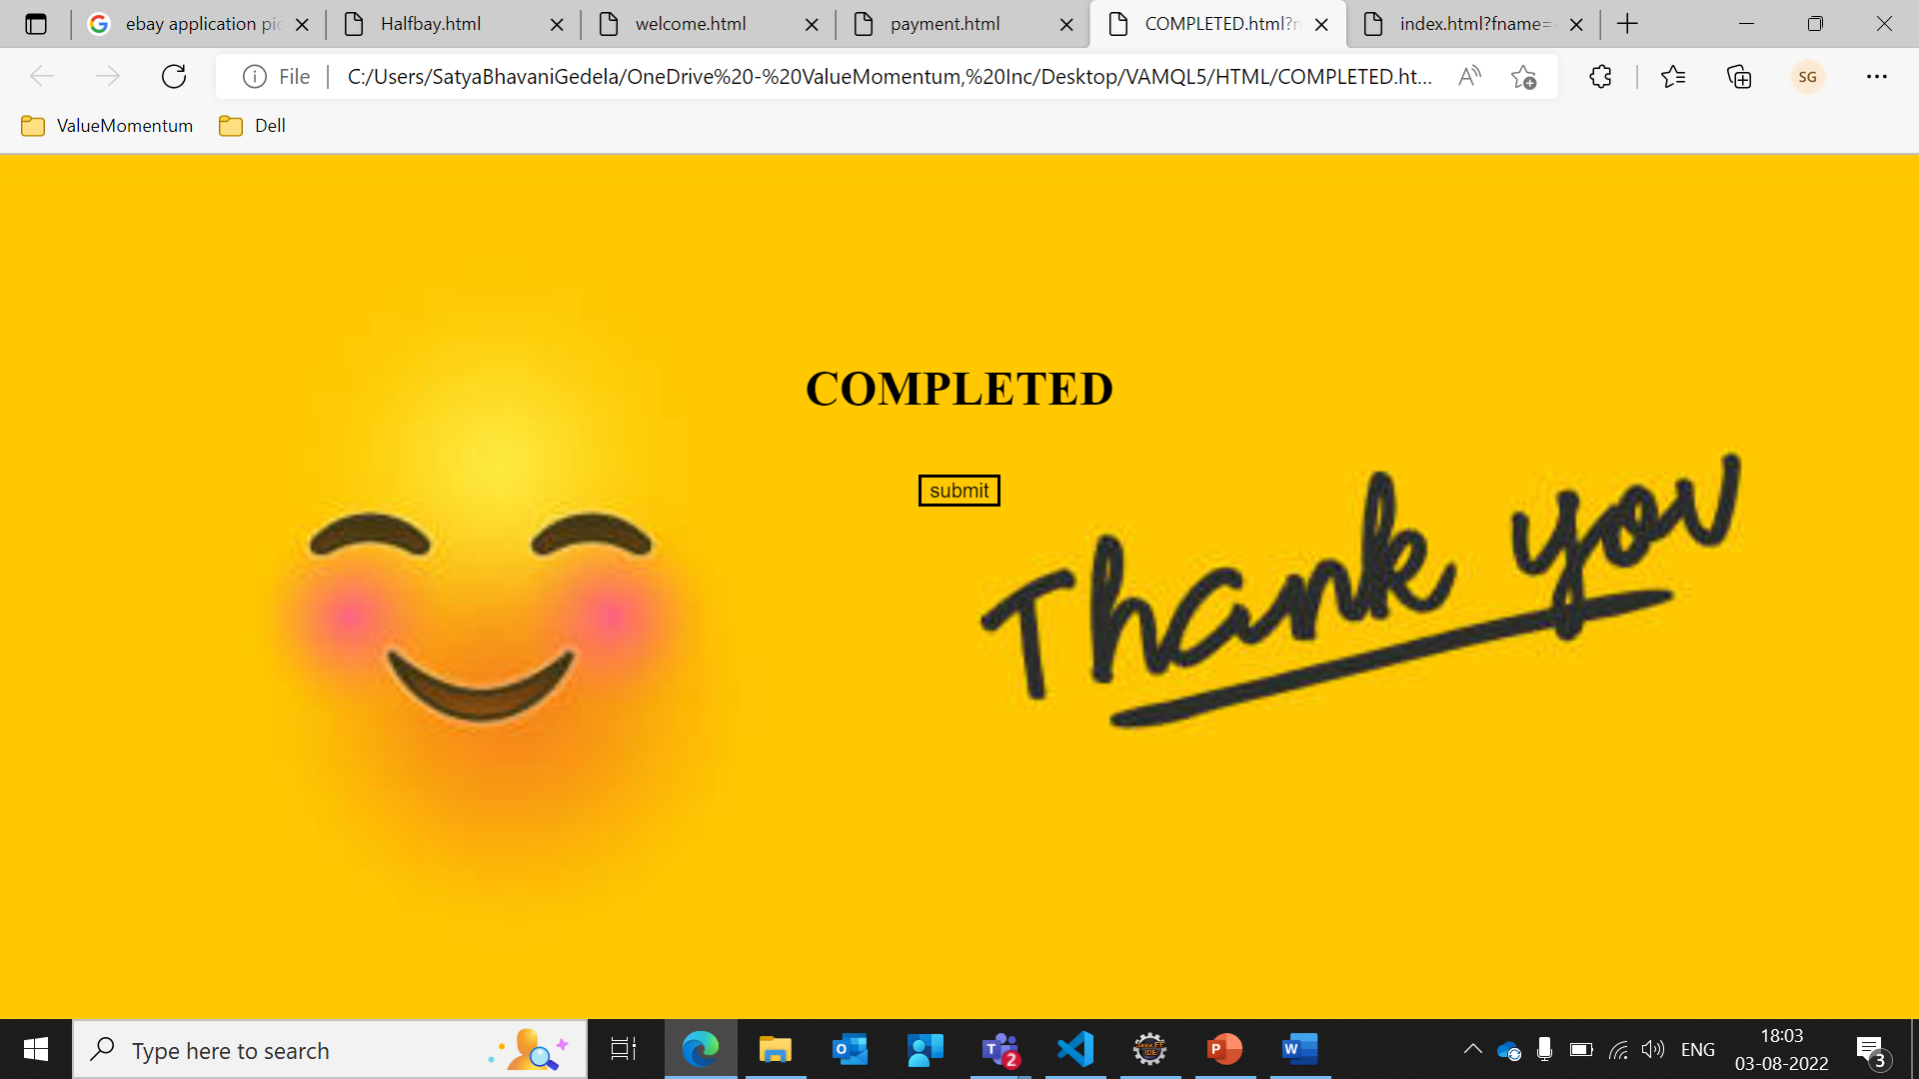
Out Put Screens Web Application Of EBAY

Slide 6
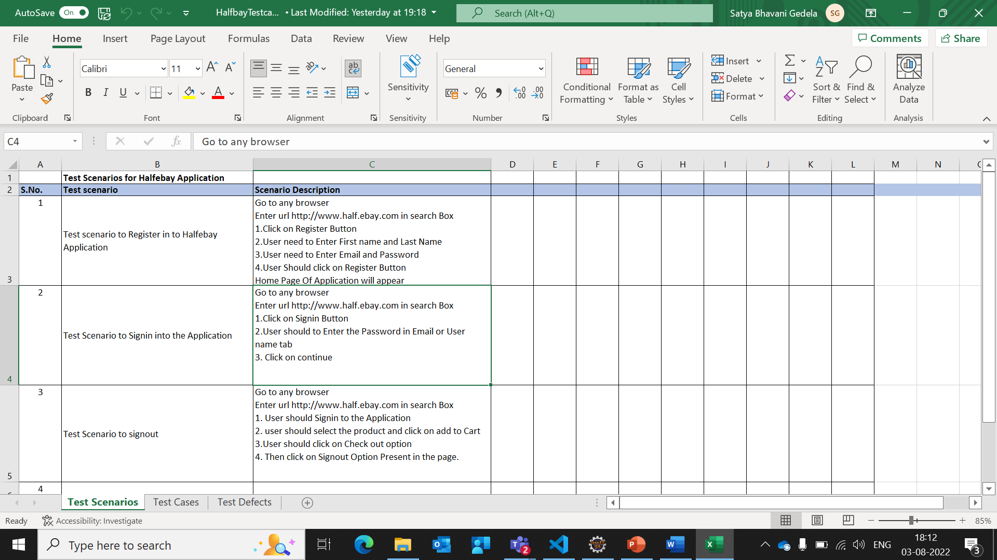
Test Scenario
A test scenario is defined as any functionality that can be tested.
It is also called test condition or test possibility.
As a tester, you should put yourself in the end user’s shoes and figure out the real-world scenarios and use cases of the application under test.
Test scenarios can be approved by various stakeholders like business analyst, developers, customers to ensure the application under test is thoroughly tested. It ensures that the software is working for the most common use cases.

Slide 7
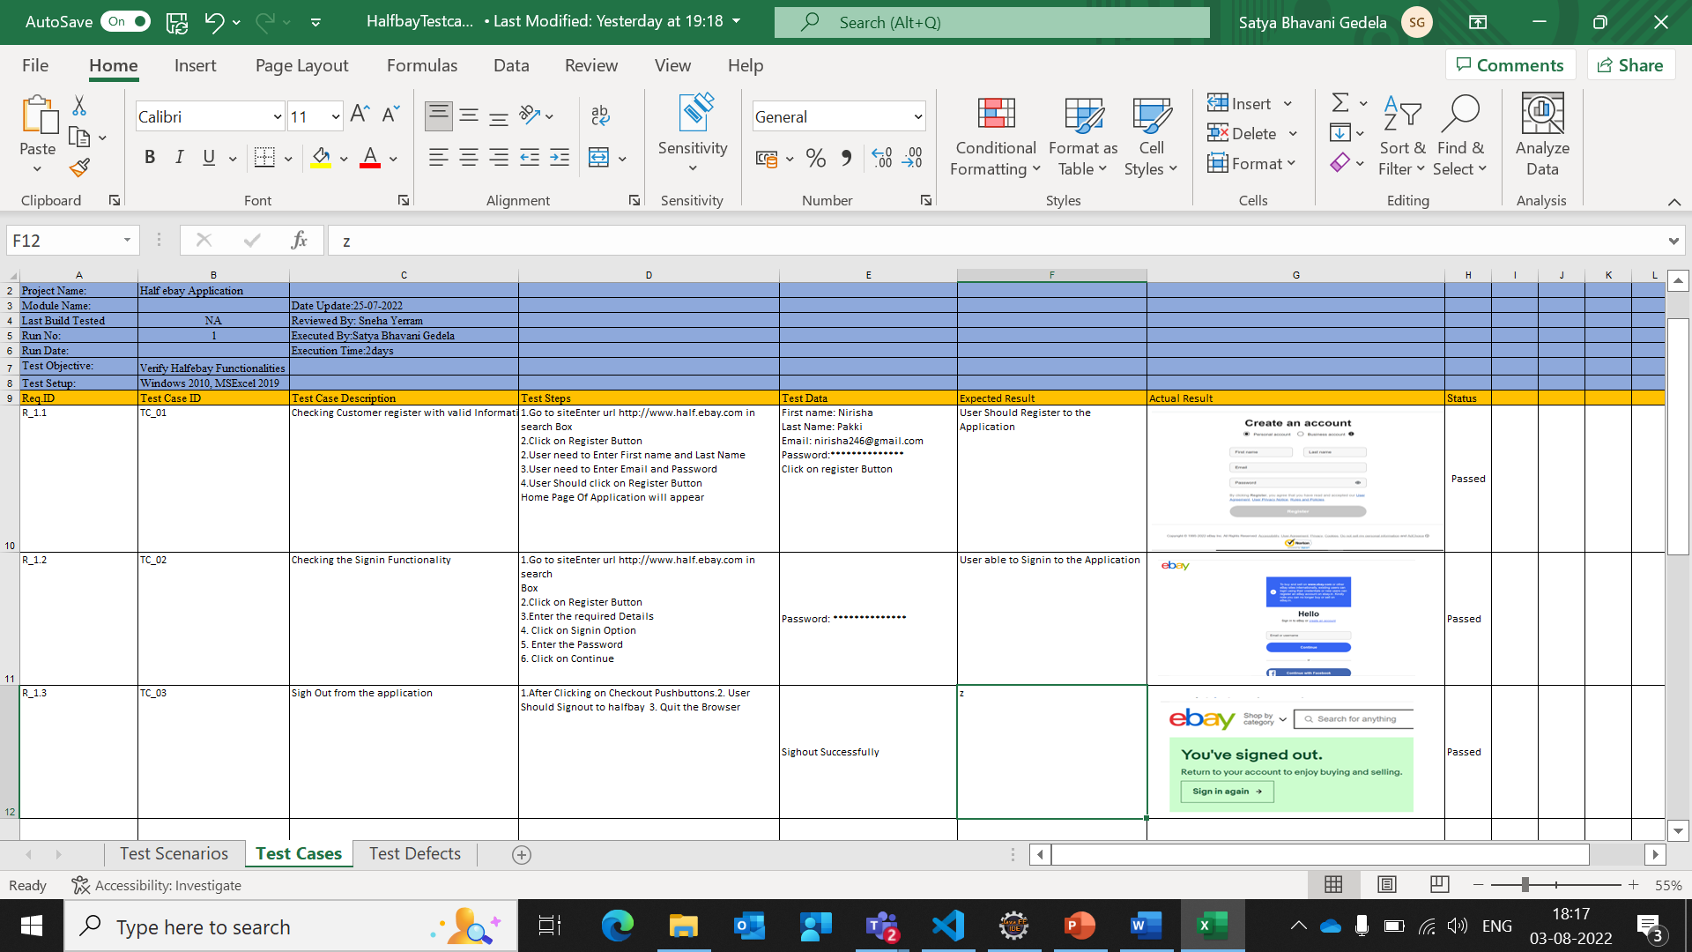
Test Case
A test case is a set of actions executed to verify a particular feature or functionality of your software application.
A test case contains test steps, test data, precondition, postcondition developed for specific test scenario to verify any requirement

Slide 8
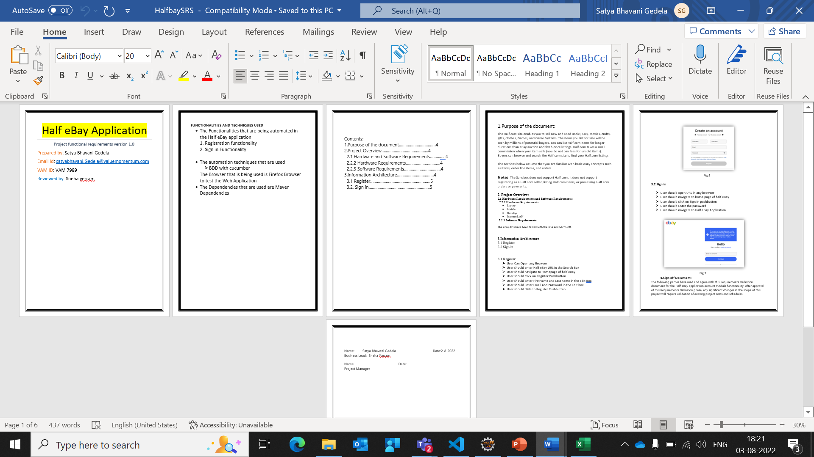
Srs Document
A software requirements specification (SRS) is a document that describes what the software will do and how it will be expected to perform. It also describes the functionality the product needs to fulfill all stakeholders (business, users) needs.

Slide 9

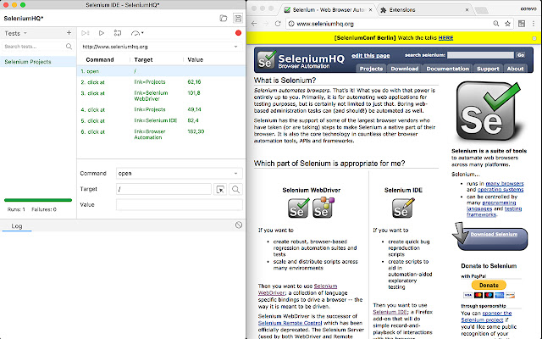
Selenium IDE
•Selenium IDE (integrated development environment) is primarily a record/run tool that a test case developer uses to develop selenium test cases. Selenium IDE is an easy-to-use tool from the selenium test suite and can even be used by someone new to developing automated test cases for their web applications

Slide 10
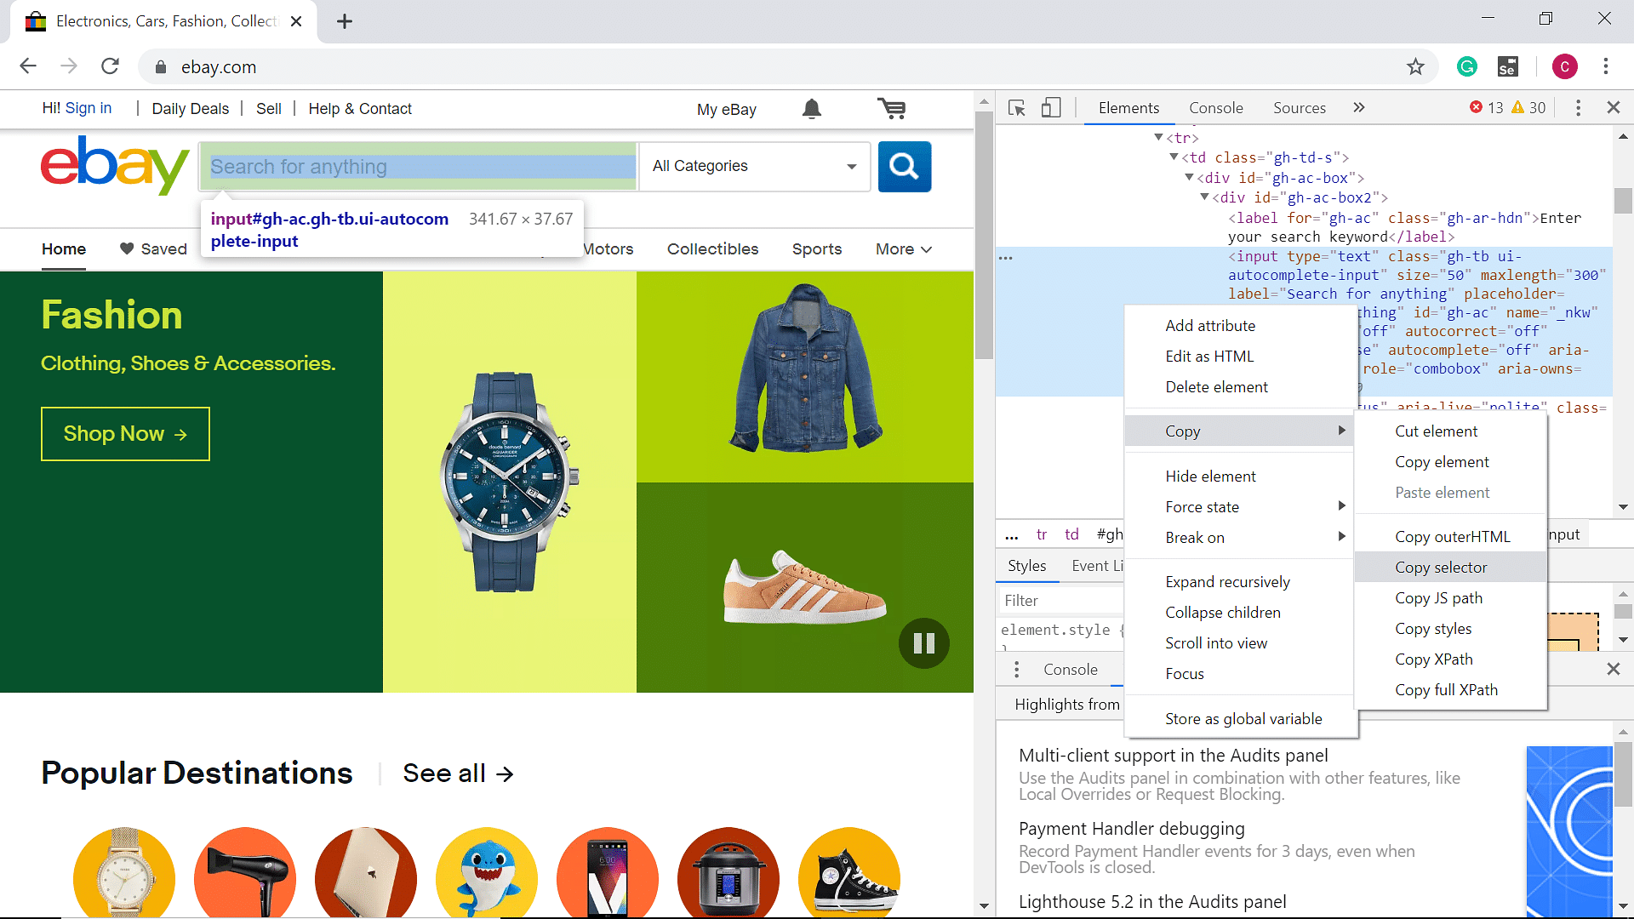
Selenium Web driverb
Selenium webdriver is a web framework that permits you to execute cross-browser tests. This tool is used for automating web-based application testing to verify that it performs expectedly. Selenium webdriver allows you to choose a programming language to create test scripts. Web framework that permits execute cross-browser tests. This tool is used for automating web-based application testing to verify that it performs expectedly. Selenium webdriver allows you to choose a programming language to create test scripts.

Slide 11

THANK YOU

